Slide 1
Let's fill this town with linguists
TranslationsInLondon Ltd

Slide 2
Language in Human Communication.
It speaks to the power of language in creating a connection with another person and building a sense of understanding and empathy.
Learning a new language is not just about gaining a new skill or enhancing career prospects
We can demonstrate a level of respect and appreciation for culture and identity.
“If you talk to a man in a language he understands, that goes to his head. If you talk to him in his own language, that goes to his heart.”
Nelson Mandela

Slide 3
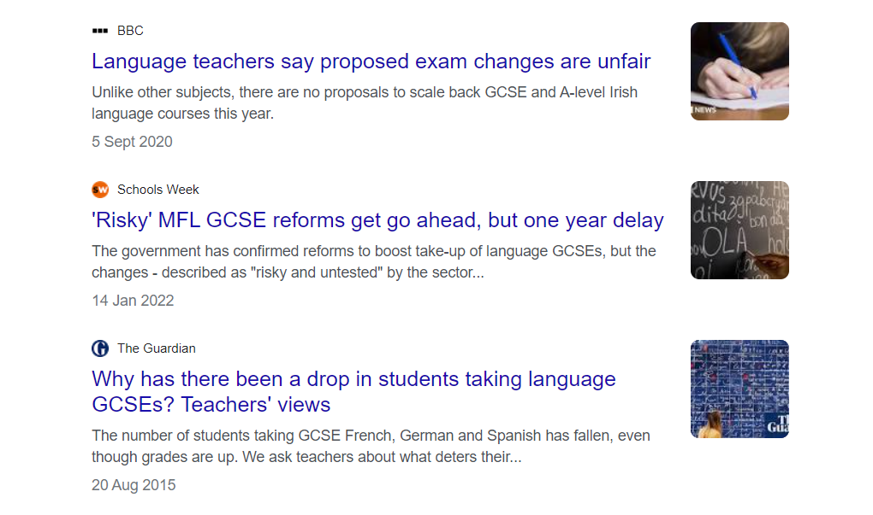
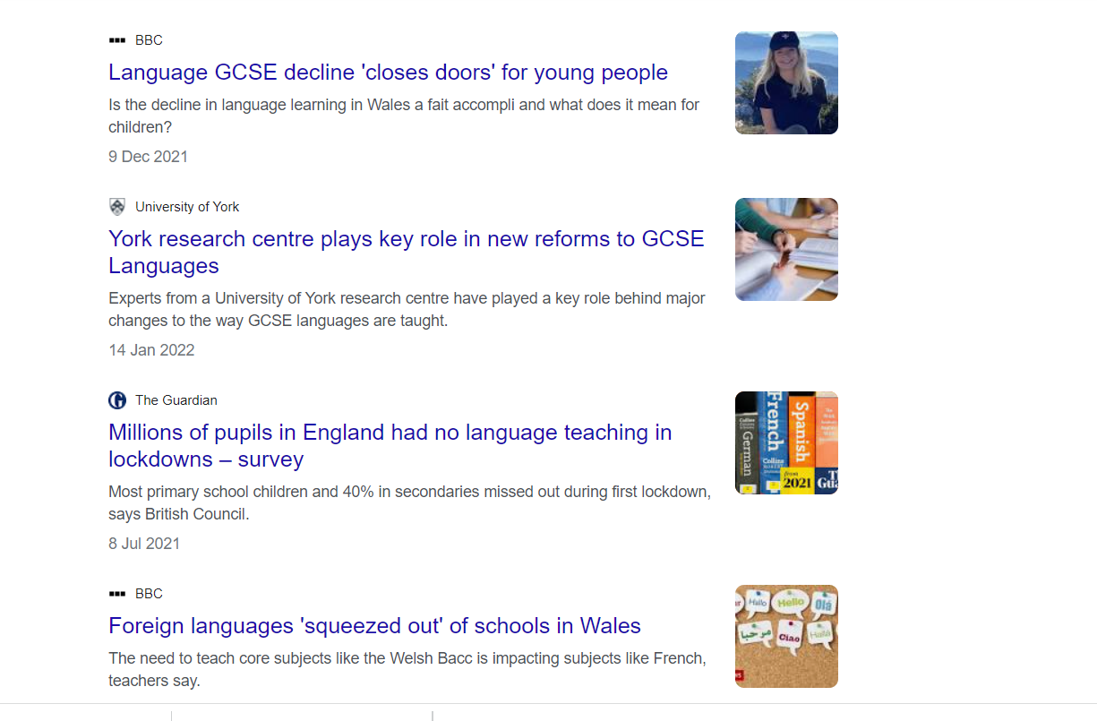
Why did TIL choose to work on this initiative?

Slide 4
The Current State of Modern Foreign Languages In Education.
Concerning decline in Modern Foreign Languages (MFL) in the UK.
Shortage of skilled linguists due to declining MFL students.
Knowing more than English is vital.
To address this issue, companies like TranslationsInLondon (TIL) are doing their bit to promote language learning and career languages in school. TIL offers a range of language services, including translation, interpreting, and multilingual staff.

Slide 5
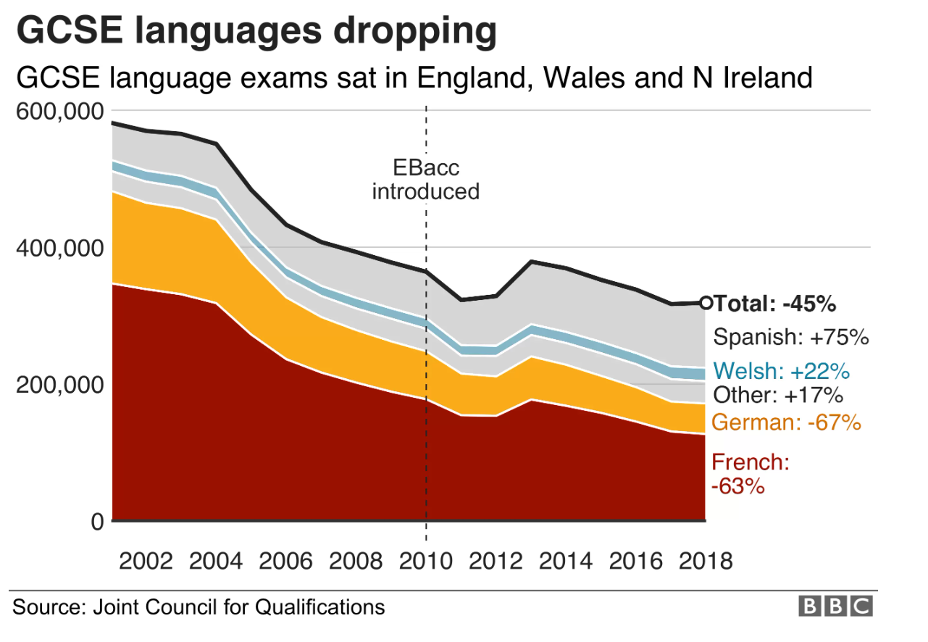

Slide 6
What are the Skills and Work Prospective for MFL?
Many people assume that speaking a language fluently automatically qualifies them to work as a translator.
Translation is a highly specialized skill that requires much more than just fluency in a language.
The skills needed will be presented later in the presentation.
In this room, there will many bilingual (by birth) students and often act as interpreter.
That would give you an idea of how difficult is, especially with medical terms.

Slide 7
Working With Languages.
Translator/Interpreter:
Travel:
Teacher:
Diplomat:
A translator, where one can bridge the gap between languages, transferring meaning and context from one language to another.
Interpreters play a vital role in facilitating effective communication between speakers of different languages in real-time settings.
In the tourism industry, multilingual professionals such as guides, air hostesses, and staff enable seamless communication and enhance the travel experience for international visitors.
Teachers of foreign languages contribute to the education sector, helping students develop language proficiency and cultural understanding.
Diplomats and professionals working in EU institutions utilize language expertise to engage in international relations and promote effective communication among nations.
The field of working with languages is vast, rewarding those who possess strong language skills and a passion for cultural exchange.

Slide 8
Skills Needed for Translation:
Linguistic proficiency is paramount.
Excellent command of both the source and target languages, including a deep understanding of grammar, vocabulary, idiomatic expressions, and cultural nuances.
Attention to detail and strong research skills.
Strong written and verbal communication skills.
Educational background in languages or translation (A degree in linguistics, translation studies, or a related field.)
Knowledge in specialized fields (i.e., legal, medical, technical, or literary translation.)
Continuous professional development.

Slide 9
Skills Needed for Interpretation:
Exceptional language proficiency in at least two languages: the source language (the language spoken by the speaker) and the target language (the language into which the interpretation is provided).
A strong command of vocabulary, grammar, idiomatic expressions, and cultural nuances.
Excellent listening and comprehension skills.
Have strong verbal communication skills.
Cultural competency.
Formal education and training in interpretation are highly recommended.
professional development to stay updated on industry best practices, new terminology, and technology advancements.

Slide 10
Working Freelance:
🚀 Entrepreneurial Spirit:- You are running your own business. You need to be proactive, self-motivated, and determined. You will be building a strong professional network, marketing your services, and managing your finances.
🔑 Soft Skills:- Communication: You must be able to clearly understand clients' requirements, ask relevant questions, and convey messages accurately and fluently. Active listening and strong verbal and written communication skills are vital.
Time Management: Freelancers have multiple projects and deadlines to juggle; you need to meet client expectations and deliver high-quality work on time. Organizing your schedule, setting priorities, and staying disciplined are essential.
Adaptability: The freelance translation/interpretation landscape is dynamic and ever-changing. Adapting to different subject matters, industries, and working environments is crucial. Flexibility, open-mindedness, and the ability to learn quickly are valuable assets.
Problem-Solving: Could be translating/interpreting complex texts or situations, so you must be resourceful, able to research and find solutions independently, and make sound decisions to overcome linguistic challenges.
Cultural Sensitivity: You need to navigate diverse cultural contexts and adapt your work to ensure accurate and culturally appropriate translations or interpretations.

Slide 11
Any Questions?

Slide 12
Thank you for listening!

